Slide 1
CS 377
Discussion 1
Andrew Danise
adanise@cs.umass.edu

Slide 2
Administrative Stuff
Purpose of this discussion section
  Keep up with reading and lectures (short quizzes)
  Review course material (working out problems)
TA Office hours
  (poll class)

Slide 3
Homework
Weekly homework
Released every Wednesday
  Posted on Piazza
Due by 4pm the following Monday
  Submit to Gradescope
Used to keep up with the course material
10% for final grades

Slide 4
Outline for Today
Learning outcomes and Review of Week 1
Program demo
C/C++ refresher

Slide 5
Learning outcomes and Review
Lecture 1:
Definition of an operating system
What are OS design goals?
What is uniprogramming? What is multiprogramming?
Benefits of overlapping I/O and computation
What is Moore’s Law?

Slide 6
Program demo
CPU virtualization
– cpu.c
– compile: gcc cpu.c -o cpu
– run: ./cpu <string>
Concurrency
– threads.c
– compile: gcc threads.c -lpthread -o threads
– run: ./threads <number>

Slide 7
C++ Review
C++ concepts
  Structs
  Classes
  Pointers
Homework Q5

Slide 8
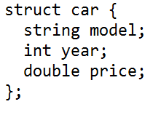
Structs
Collection of data, short for data structure
Can have different data types
Example:

Slide 9
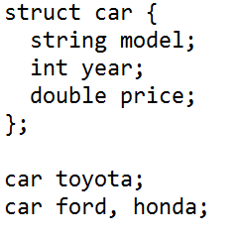
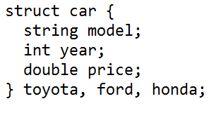
Structs
Can have multiple instances
Examples:

Slide 10
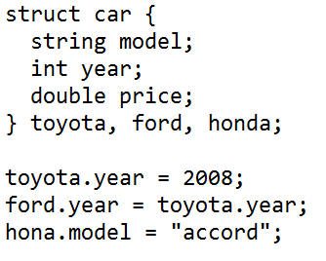
Structs
Fields are inherently public
Example:

Slide 11
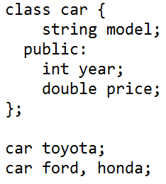
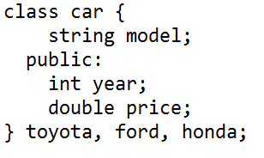
Classes
Much like structs, except usually contain functions
Fields are inherently private
Fields and functions grouped by access specifiers
Can have multiple instances (objects)
Examples:

Slide 12
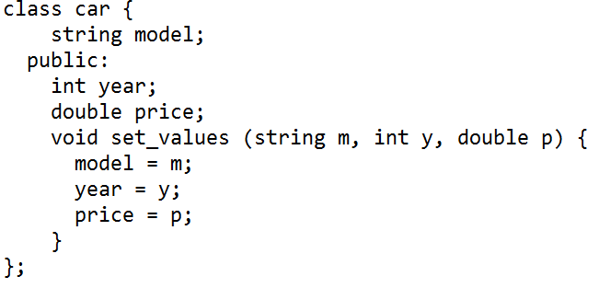
Classes: Functions
Two ways to do function definitions
Example of normal way:

Slide 13
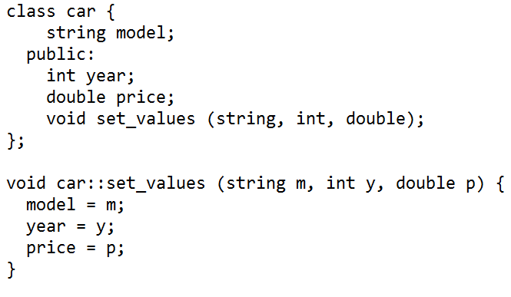
Classes: Functions
Example of other way:

Slide 14
Classes: Constructors
Constructors are like Java's
  Function name is same as class name
  Accepts parameters and assigns them to fields
How can we modify set_values from the previous two examples to become car's constructor?

Slide 15

Pointers
Variables that contain memory addresses to other variables
Declaration: type* name
Examples:

Slide 16


Pointers: Referencing and Dereferencing
Assign addresses of variables to pointers using the & operator
Example:
Access values of variables that pointers point to using the * operator
The following example is a true statement:

Slide 17
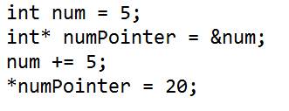
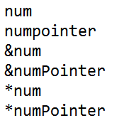
Pointers: Referencing and Dereferencing
If num is at memory location 100 and numPointer is at memory location 200, what are the values of the following:

Slide 18
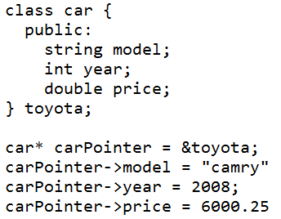
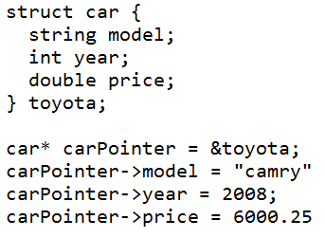
Pointers: Structs and Classes
To access a field or function of a struct or class that a pointer points to, use the -> operator
Examples:

Slide 19
Homework Q5
Goal: Write C++ code to implement a linked list.
Code template is provided in the discussion handout.
Specifications:
  get familiar with the code template
  you only need to implement the insert and remove methods inside the linked list class
Submit through Gradescope

Slide 20
Programming Assignment
Code template go-through
  template.cpp

Slide 21
Useful resource for C and C++
http://www.cplusplus.com/doc/tutorial/
http://www.cprogramming.com/tutorial.html
C and C++ for Java programmers:
http://www.cprogramming.com/java/c-and-c++-for-java-programmers.html

